Slide 1


AI Implementation
in Healthcare
Transforming charting through Generative AI
Presented by: Christiana Okonko, Cole Shankles, Grace Fadeyi, Kevin Hill
Team 4 | AI Implementation in Healthcare

Slide 2


The Challenge
Time-Consuming Documentation
Nurses spend up to 2 additional hours per shift on data entry, cutting into time that could be spent providing direct patient care.
Quick and accurate transcription of patient data is critical delays can be the difference between life and death in hospital settings.
Team 4 | AI Implementation in Healthcare | 1

Slide 3





Our Solution
AI/Voice integration software
Tool that nurses will speak into and then transcribe and extract Important Information to fill chart​
A focus on general information such as blood pressure, heartrate, general background and information​
Team 4 | AI Implementation in Healthcare | 2

Slide 4



Strategic Value of AI
Time Savings
Enhanced Accuracy
Risk Reduction
Reduces documentation burden, freeing nurses to focus on patient care and critical decision-making.
Structured data extraction minimizes transcription errors and ensures consistent formatting.
Predictive analytics flag patient deterioration risks by analyzing trends in charted data.
Team 4 | AI Implementation in Healthcare | 3

Slide 5
Core Gen AI Capabilities
01
02
Speech-to-Text
NLP Extraction
OpenAI Whisper and Deepgram enable automatic speech recognition allowing conversion of dictation to text instantly.
LLMs like GPT-4o and Claude read transcripts and extract structured data: vitals, medications, observations.
03
04
Risk Alerting
Clinical Coding
Google Health AI and IBM Watson summarize patient risk flags from health records.
AWS Comprehend Medical and scispaCy recognize ICD-10 codes and clinical terminology.
Team 4 | AI Implementation in Healthcare | 4

Slide 6
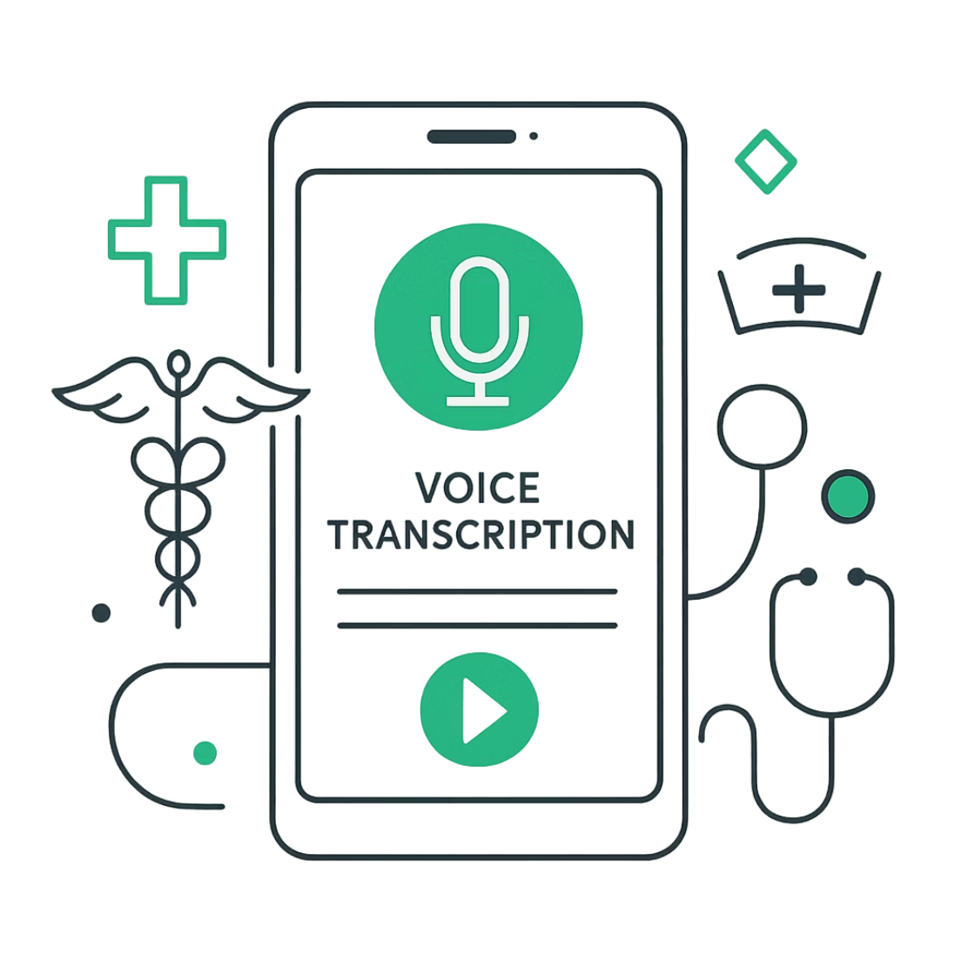
TriageNotes AI
Built with Google AI Studio using Gemini 3 Flash, TriageNotes AI processes audio recordings in a single pass, generating both verbatim transcription and structured EHR data.
Compatible with all device types, the tool integrates directly with existing electronic health record platforms for seamless data population.
Team 4 | AI Implementation in Healthcare | 5

Slide 7
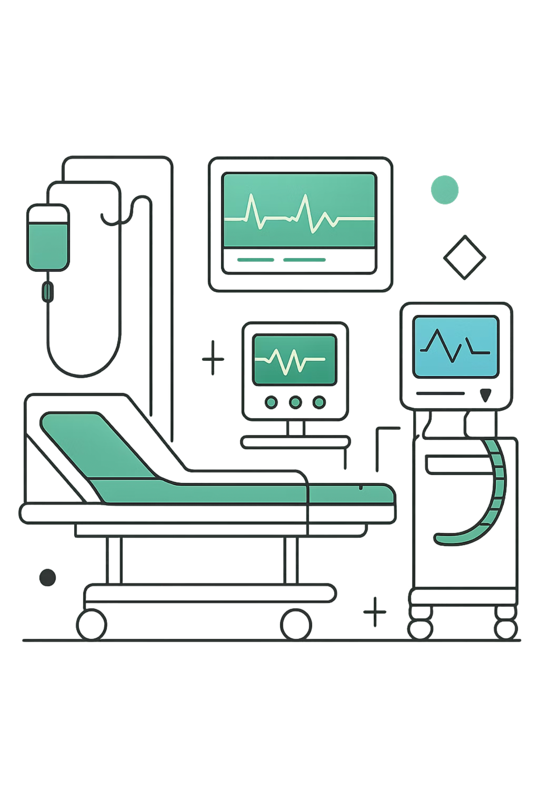
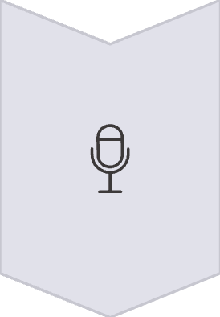
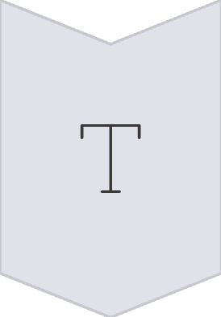
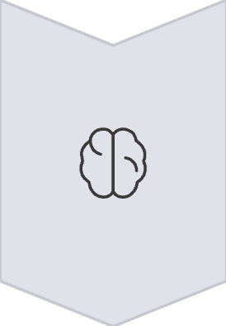
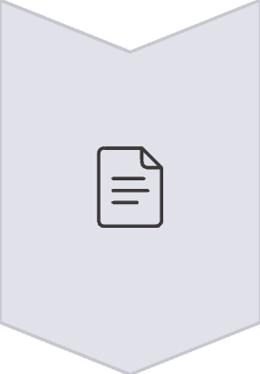
Implementation Process
Audio Capture
Nurses dictate patient information using microphones or mobile devices during assessments.
Transcription
Speech-to-text engine converts audio into written transcriptions in real time.
Data Extraction
Fine-tuned LLM extracts vitals, symptoms, and status using clinical terminology.
EHR Integration
Formatted data populates hospital's standardized chart with human verification.
Team 4 | AI Implementation in Healthcare | 6

Slide 8
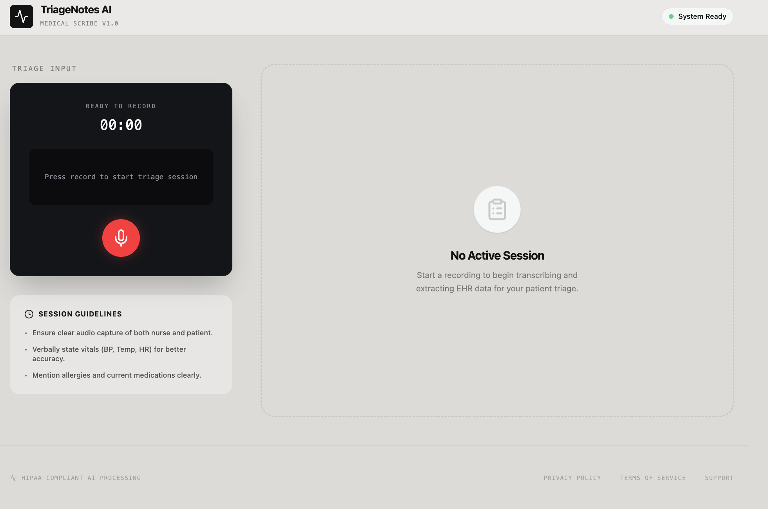
Team 4 | AI Implementation in Healthcare | 7

Slide 9
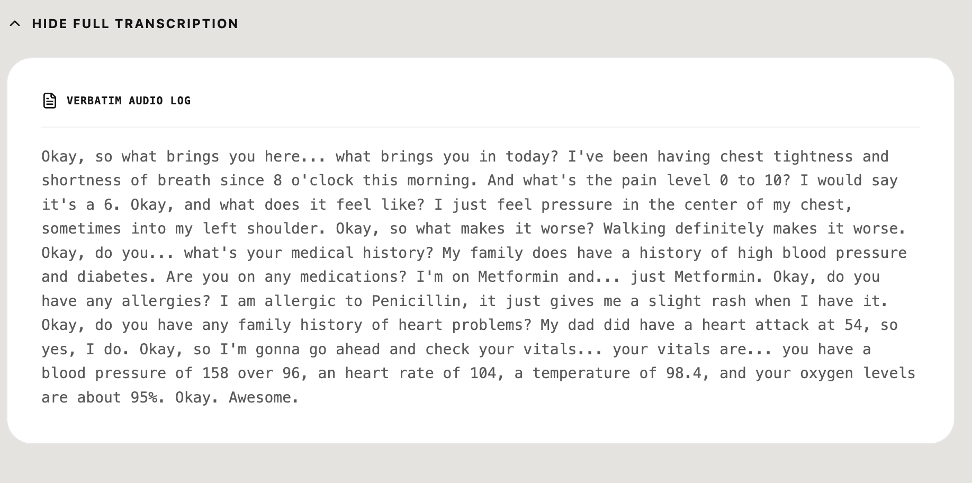
Team 4 | AI Implementation in Healthcare | 8

Slide 10
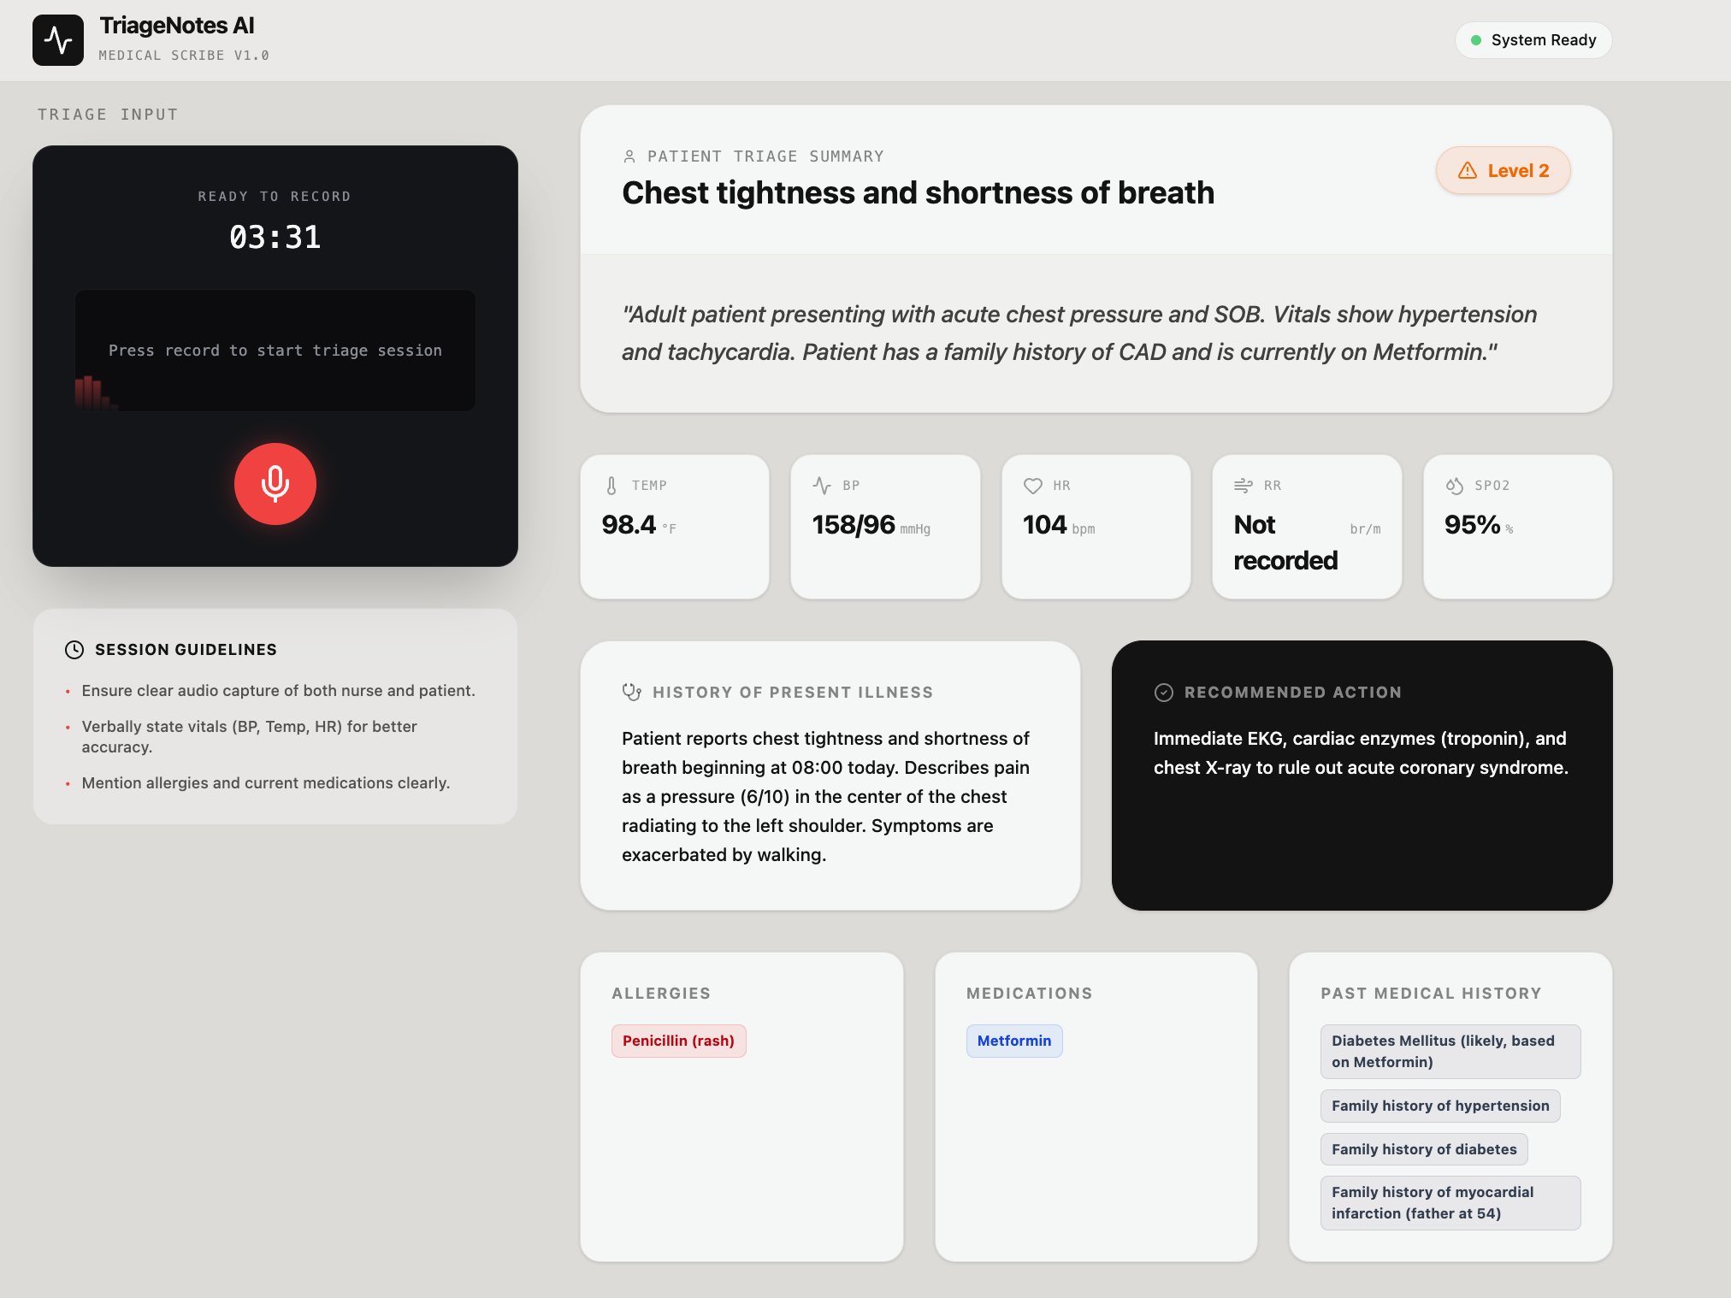
Team 4 | AI Implementation in Healthcare | 9

Slide 11
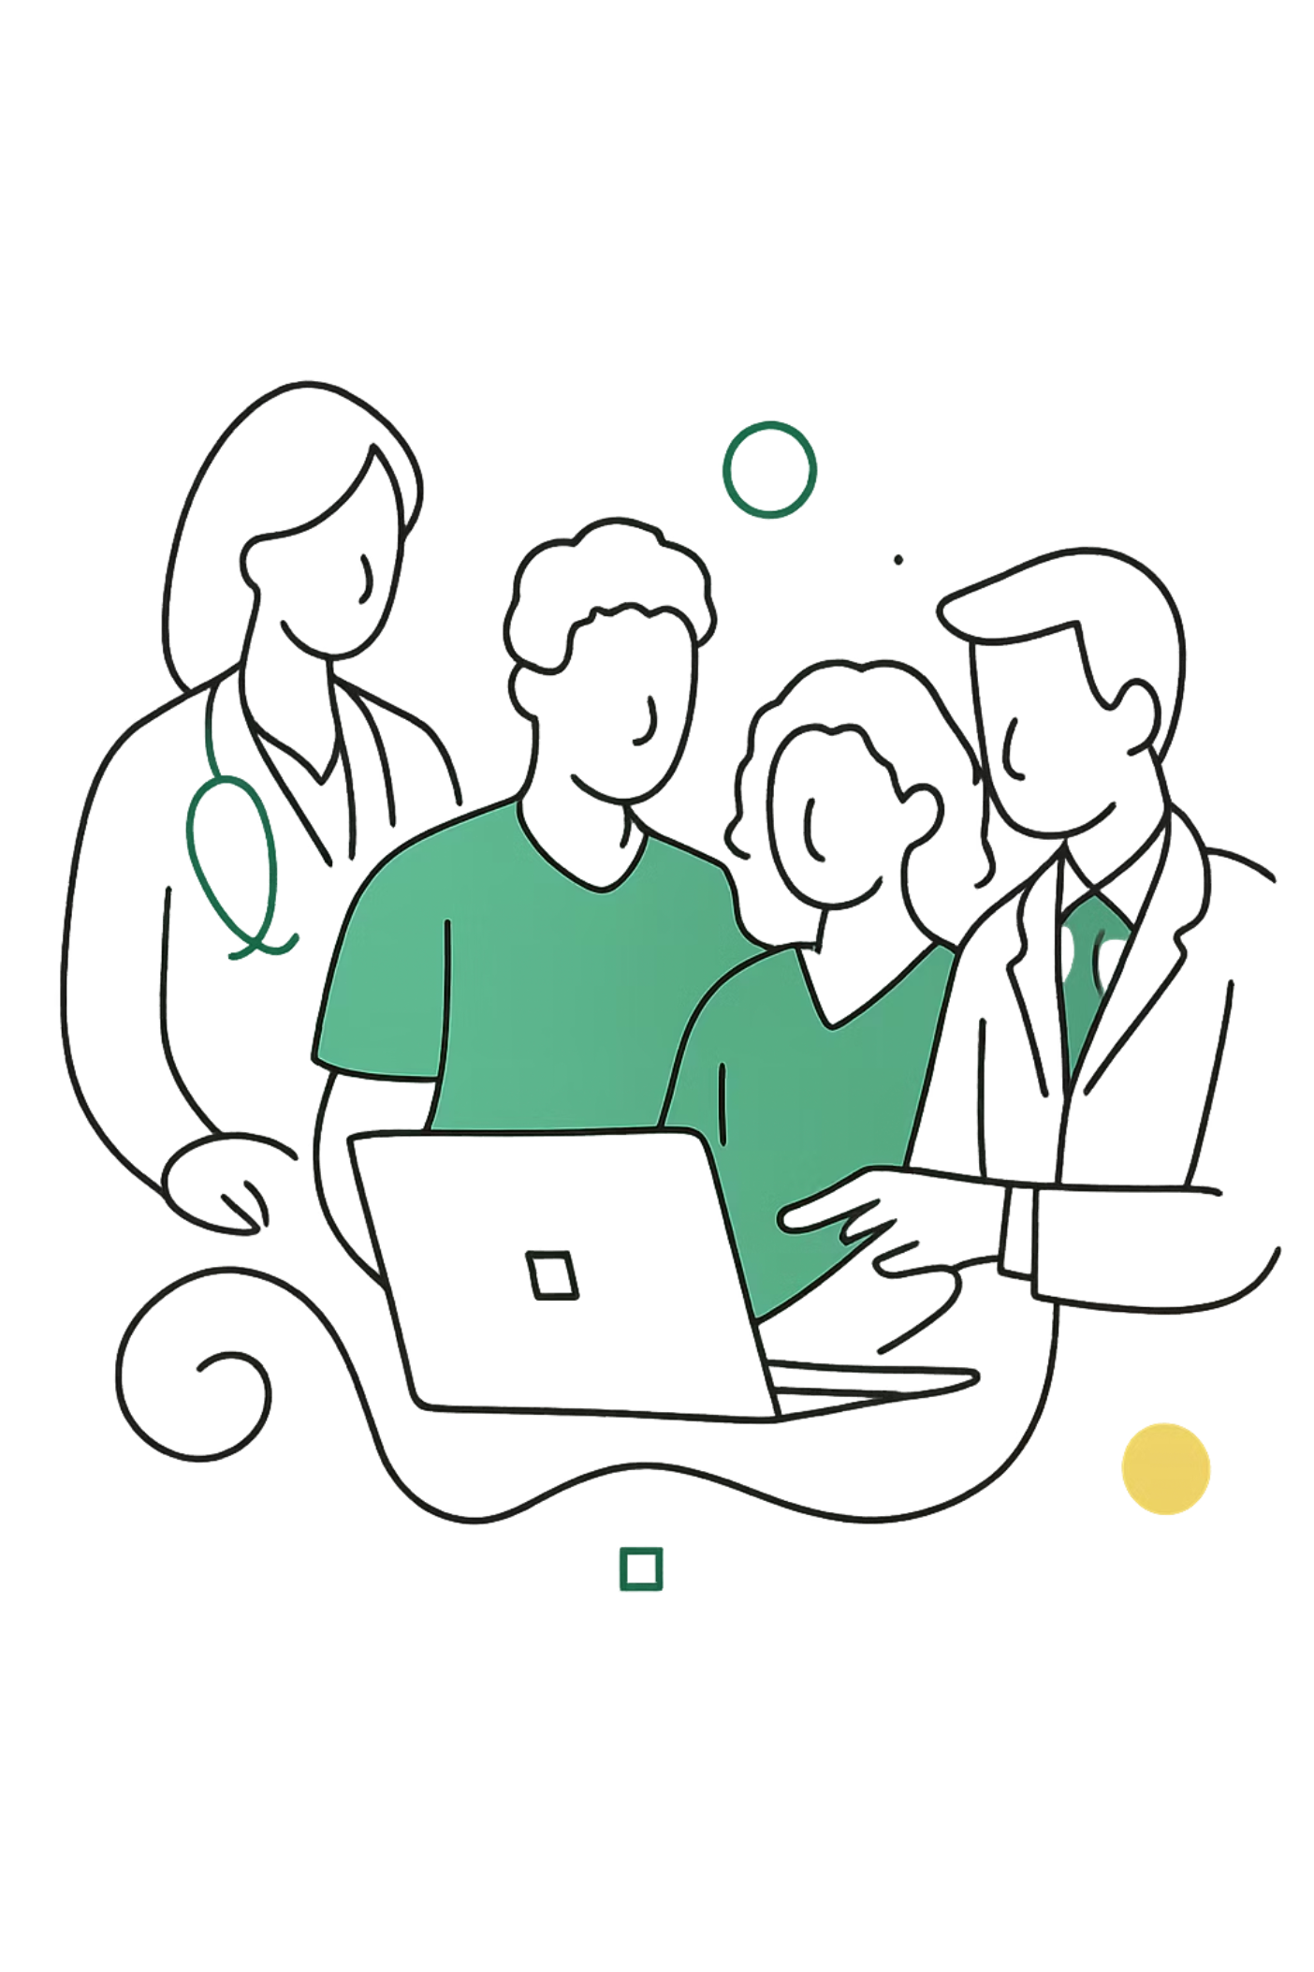
Key Takeaways
Efficiency Gains
AI significantly improves efficiency in routine clinical tasks, especially repetitive documentation. Nurses can focus more on direct patient care and critical thinking.
Human Oversight Essential
Healthcare requires high accuracy, privacy, and trust. AI should support, not replace, clinical professionals. Human review ensures correct, contextually appropriate records.
Usability Matters
Effective AI solutions must fit naturally into existing workflows. Tools that are complicated or disruptive face low adoption regardless of technical strengths.
Team 4 | AI Implementation in Healthcare | 10

Slide 12



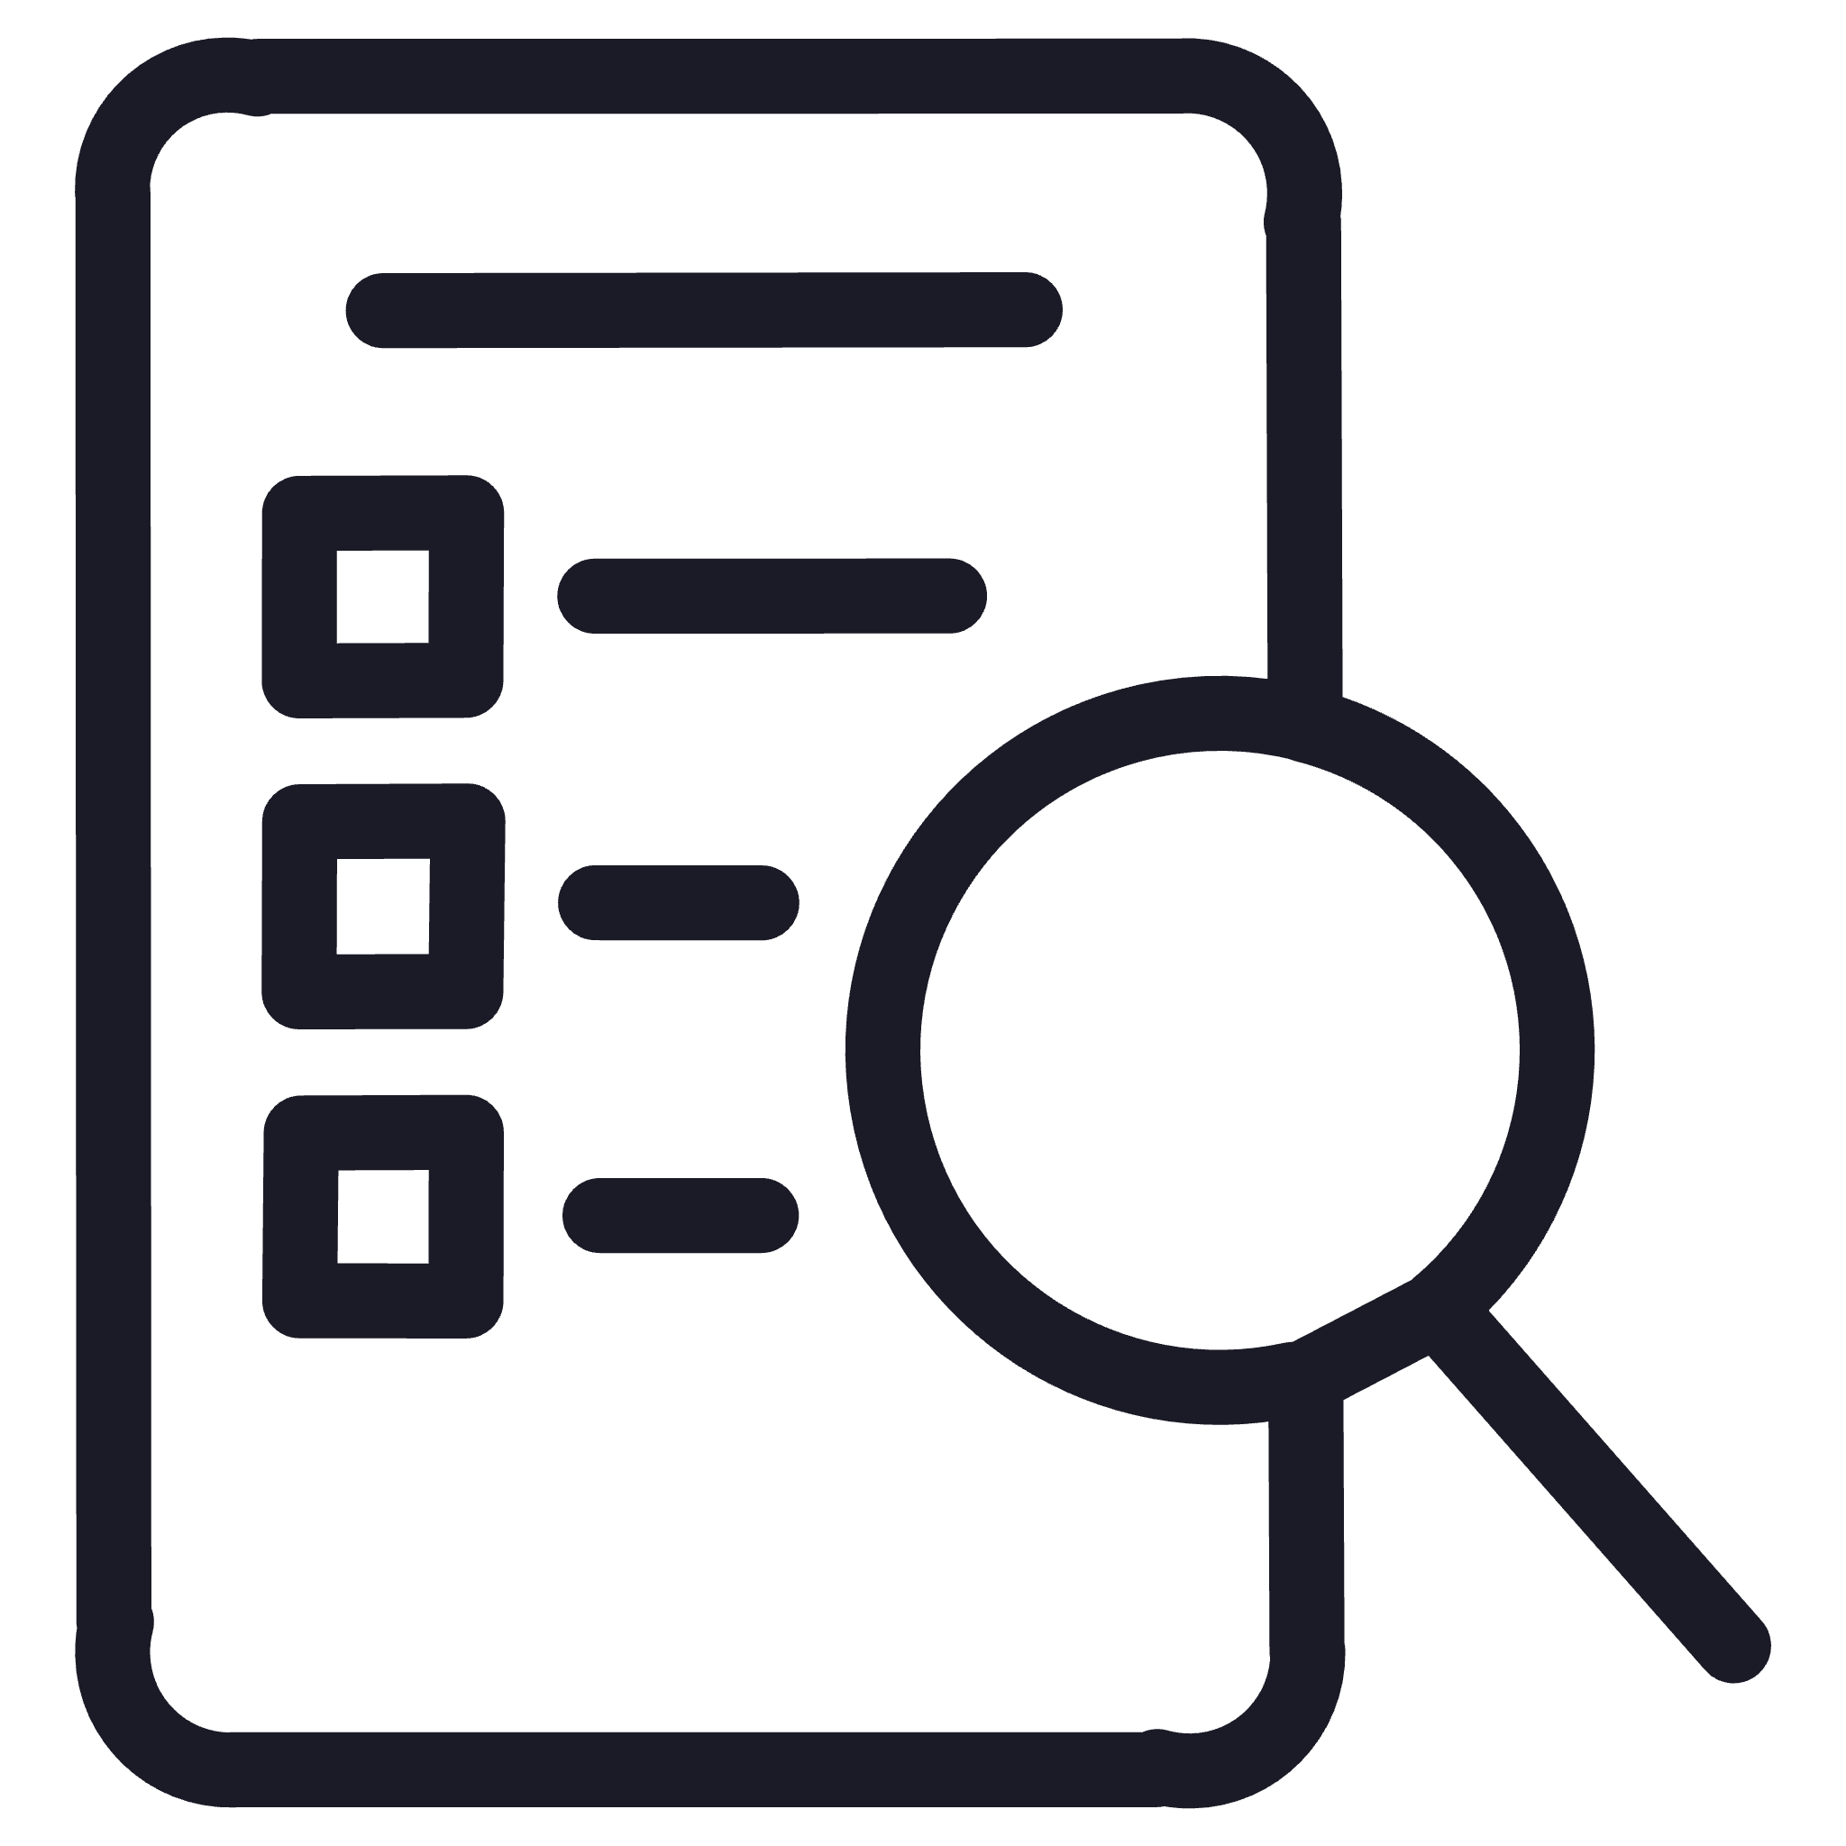
Future Improvements
Multilingual Support
Noise Filtering
Enhance system to serve diverse patient populations and healthcare staff with multiple language capabilities.
Incorporate ambient noise filtering and speaker recognition to improve accuracy in busy hospital environments.
Predictive Analytics
Clinical Testing
Integrate trend analysis to flag patient deterioration risks by monitoring charted data over time.
Conduct pilot testing in real clinical environments to gather feedback for usability and accuracy improvements.
Team 4 | AI Implementation in Healthcare | 11

Slide 13

Strategic Impact
Professional Value
This project demonstrates Generative AI's strong potential to improve healthcare operations when implemented thoughtfully. TriageNotes AI represents a practical example of how AI can reduce administrative burden while supporting safer, more efficient patient care.
By balancing technical capability with usability and maintaining human oversight, AI-assisted documentation can transform nursing workflows and enhance patient outcomes.
Team 4 | AI Implementation in Healthcare | 12

Slide 14
Thank You!
Any Questions?
Team 4 | AI Implementation in Healthcare

